Slide 1
Get the most out of Azure SQL’s .NET client development stack: SqlClient 4.x and EF Core 6
Silvano Coriani
Program Manager, Azure SQL

Slide 2

Feedback link
Please submit your feedback here:
https://sqlb.it/?7220

Slide 3
Agenda
Introduction
What’s new in Microsoft.Data.SqlClient 4.x
Configurable Retry Logic
What’s new for EntityFramework Core 6
Temporal tables support
Performance
Azure SQL DB and EF Core 6 performance considerations

Slide 4
SQL Server Experiences
Graphical Interfaces
Notebooks
CLI and Scripting
Drivers and Libraries
SQL Server Engine
Azure Portal | Azure Data Studio | SSMS | SSMS
SQL Projects in Visual Studio | Mssql Ext to VS Code | SSMA | SSMA
Legacy Tools
Notebook Viewer | Jupyter Books | Kernels | Jupyter Books
Notebooks as Documentation | Notebooks as User Experiences
Sqlcmd | Sqlpackage | Azdata
Mssql-cli | Powershell | BCP
Legacy Utilities
SMO | DacFX
Drivers (SqlClient, JDBC, ODBC, OLEDB, PyODBC, PHP, Tedious/Node.js, Go)
T-SQL | DDL
Trace Flags | Startup Parameters

Slide 5
Drivers and libraries
Support application development for most modern programming languages and frameworks
Available for most Operating Systems, including Windows, macOS and Linux (and UNIX)
Main client drivers (SqlClient, JDBC, ODBC and OLE DB) provide complete coverage of various service features in the areas of
Programmability
Security
Performance
Management

Slide 6












Connectivity for top programming languages
C#
Java
C/C++
PHP
JavaScript
Python
Ruby
SQLAlchemy/Django
Laravel
Tedious Node.js Driver
Pyodbc/Pymssql
TinyTDS
.NET Framework
.NET Core
Ruby on Rails
Entity Framework Core
JDBC
Hibernate
ODBC
msphpsql
Sequelize
ODBC
ODBC/FreeTDS
FreeTDS
TDS protocol
Legacy SQL Server on premises
SQL Server in 3rd party clouds & containers
SQL Server
2019
Azure
SQL Database
Synapse / Azure SQL Data Warehouse
SQL Server in Azure VM
SQL
DW

Slide 7
Azure SQL programming from .NET
Three main options:
Microsoft.Data.SqlClient classes
You’re in control of everything
Full-featured ORM like Entity Framework Core
You want the tool to take care of all database interaction for you
Lightweight ORM like MicroORM
You just want to execute queries as fast a possible and map it to a class
Dapper, Massive, PetaPoco, Simple.Data, OrmLite
https://medium.com/dapper-net

Slide 8
Microsoft.Data.SqlClient

Slide 9
Microsoft.Data.SqlClient
The future-proof library to connect and use Azure SQL
https://devblogs.microsoft.com/dotnet/introducing-the-new-microsoftdatasqlclient/
Supports .NET Framework, .NET Core, .NET Standard, and .NET.
Open Source
https://github.com/dotnet/SqlClient
Install via NuGet
Drop-In replacements for System.Data.SqlClient
SqlConnection, SqlCommand, SqlDataReader, etc.

Slide 10
What’s new in Microsoft.Data.SqlClient v4.x
Encrypt = true, by default (disabled for LocalDB)
Configurable Retry Logic GA
Safety switch removed
Updated retriable error list
Added SqlCommand.EnableOptimizedParameterBinding property that when enabled increases performance for commands with very large numbers of parameters
GetFieldValueAsync<T> and GetFieldValue<T> support for XmlReader, TextReader, Stream types
Many perf-related improvements especially around async methods
Dropped support for .NET Core 2.1
Added support for Event counters in .NET Core (from v3.0+)
Several improvements on Always Encrypted scenarios

Slide 11
Introducing Configurable Retry Logic in Azure SQL client drivers

Slide 12
Transient issues and application reliability
Distributed apps in the cloud can suffer from transient issues due to multiple root causes.
Azure SQL High Availability architecture dynamically reconfigures servers to respond to events like planned and unplanned maintenance (from software upgrades to hw failures).
While most reconfigurations happen in few seconds (usually between 2 and 8 sec), client applications can lose connections to the database and receive error codes providing an indication of what’s going on in the system.

Slide 13
How to solve transient connectivity issues
Retry pattern is a well-known approach to increase application reliability in cloud environments by:
Detecting if a specific error can be provoked by a transient condition
Automatically retrying the original database operation after a given delay and number of times
Various retry logic frameworks and libraries are available as OSS packages to solve this issue without reinventing the wheel
Transient Fault Handling Application Block
Polly
Tenacity
Failsafe
Existing apps rarely implement retry logic to deal with transient errors, and for new developments is not trivial to pick up the right framework/library that deals with transient errors.

Slide 14
Introducing Configurable Retry Logic in Azure SQL client drivers
Starting from Microsoft.Data.SqlClient v3.0, configurable retry logic is available out of the box for both existing apps and new development.
For existing apps, there’s no need to introduce code changes, just add few items in config file to describe what operations to retry and how to do that.
Designed to work with SqlConnection and SqlCommand operations
Connection openings, command executions.
For brand new apps, SqlClient contains new classes that can be reused to create multiple retry profiles based on your business logic.
Developers can also create their own retry provider for very specific retry policy requirements.
Plan is to expand these capabilities to all major Azure SQL client drivers over the next 12 months

Slide 15
Configurable Retry Logic
This new feature is composed by three main components:
A core API that developers can use when they create new data access applications, or refactor existing ones, to define their own retry logic provider with custom tailored behaviors and characteristics.
A default, out of the box, retry logic provider with some pre-defined behaviors (e.g. fixed interval retry, exponential retry, etc.) that developer can reuse as-is without the need of reimplementing their owns.
A configuration file schema that developers can use to enable default retry logic provider and configure what behaviors they want to associate to connection opening and command execution when a connectivity issue happens, without changing a line of code in their existing applications.

Slide 16
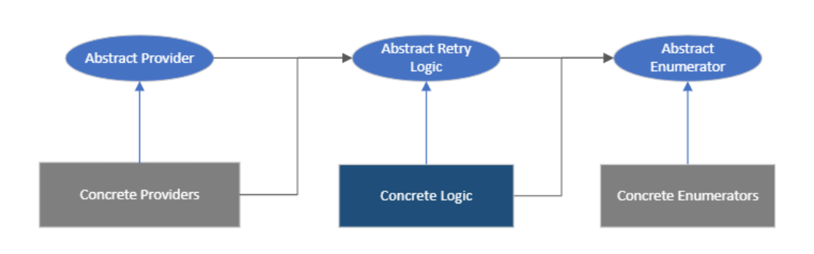
Core API
The Core API itself is designed around these three interfaces:
Enumerator: generates a sequence of time intervals that depends on a given retry logic.
Retry logic: retrieves the next time interval, considering max number of retries, if a transient condition happens.
Retry provider: applies a given retry logic to connection and command operations.

Slide 17
How to use it in existing applications
Add a reference to Microsoft.Data.SqlClient v4.0.0+
Create a specific section in your app config file
No need for changing your existing code!
<?xml version="1.0" encoding="utf-8" ?>
<configuration>
<configSections>
<section name="SqlConfigurableRetryLogicConnection"
type="Microsoft.Data.SqlClient.SqlConfigurableRetryConnectionSection, Microsoft.Data.SqlClient"/>
<section name="SqlConfigurableRetryLogicCommand"
type="Microsoft.Data.SqlClient.SqlConfigurableRetryCommandSection, Microsoft.Data.SqlClient"/>
</configSections>
<!--Retry method for SqlConnection-->
<SqlConfigurableRetryLogicConnection retryMethod ="CreateFixedRetryProvider" numberOfTries ="3" deltaTime ="00:00:10" maxTime ="00:00:30"
transientErrors="40615" />
<!--Retry method for SqlCommand containing SELECT queries-->
<SqlConfigurableRetryLogicCommand retryMethod ="CreateIncrementalRetryProvider" numberOfTries ="5" deltaTime ="00:00:10" maxTime ="00:01:10"
authorizedSqlCondition="\b(SELECT)\b" transientErrors="102, 4060, 0"/>
</configuration>

Slide 18
Retry logic attributes
For SqlConnection
numberOfTries: sets the number of times to try.
deltaTime: sets the gap time interval as a System.TimeSpan object.
minTime: sets the allowed minimum gap time interval as a System.TimeSpan object.
maxTime: sets the allowed maximum gap time interval as a System.TimeSpan object.
transientErrors: sets the list of transient error numbers on which to retry.
retryMethod: specifies a retry method creator that receives the retry configuration via a parameter and returns a provider object. In built-in retry provide available methods are
CreateFixedRetryProvider
CreateIncrementalRetryProvider
CreateExponentialRetryProvider
CreateNoneRetryProvider
retryLogicType: sets a custom retry logic provider, which contains the retry method creators that provide the retryMethod.
In addition, for SqlCommand
authorizedSqlCondition: Sets a pre-retry regular expression for CommandText to filter specific SQL statements.

Slide 19
Leverage Configurable Retry Logic in new applications
If instead you’re developing a brand-new application and want to get the most of all the available retry logic behaviors and settings, you can reuse the base classes now available and configure your own retry logic based on your requirements.
Leverage the built-in retry logic provider to define different behaviors depending on your own application logic.
E.g. only retry on specific scenarios and application patterns
Define a SqlRetryLogicOption instance and set various retry attributes
Create a SqlRetryLogicBaseProvider instance (through SqlConfigurableRetryFactory) of a specific type (e.g. fixed interval, exponential, etc.) and assign it to specific SqlConnection or SqlCommand instances.
For very special needs, you can create your own retry logic provider and assign it to SqlConnection and SqlCommand instances where needed.

Slide 20
Create a custom retry logic provider
Start from this example in our docs
Caution: by implementing a custom retry logic provider, you're in charge of all aspects, including concurrency, performance, and exception management.
Extend these 3 interfaces in your own code:
Microsoft.Data.SqlClient.SqlRetryIntervalBaseEnumerator: Generates a sequence of time intervals.
Microsoft.Data.SqlClient.SqlRetryLogicBase: Retrieves the next time interval for a given enumerator, if the number of retries has not been exceeded and a transient condition is met.
Microsoft.Data.SqlClient.SqlRetryLogicBaseProvider: Applies retry logic to connection and command operations.
Assign an instance of your custom provider to SqlConnection and SqlCommand instances in your app.

Slide 21
Demo
https://github.com/scoriani/azure-sql-db-client-stack

Slide 22
Key scenarios and use cases for retry logic
Cloud-native data applications using Azure SQL as backend database
Configurable (and extensible) retry logic framework baked into client drivers to create a more reliable user experience and respond to unexpected connectivity issues
Existing applications moving to the cloud
Add automatic retry logic by just configuring few sections in the app config file will remove many barriers and simplify migration projects of all sizes
SQL Database Serverless auto-pause warm up
Eliminate application exceptions during warm up time that a Serverless instance will need to resume from a previous auto-pause state.

Slide 23
Next Steps
Configurable Retry Logic
MS Learn: Azure SQL Fundamentals
Well Architected Framework: Optimize for scalability and reliability

Slide 24
EntityFramework Core 6

Slide 25
Data access frameworks
Boost developers' productivity by reduce repetitive code (plumbing)
E.g. Parameters and result-sets management
Object Relational Mappers (ORM) aim to go one step further and map domain objects to database objects, automatically generating SQL code for database interactions and schema management (migrations).
ORMs are often a controversial topic between database and developer communities but they shouldn’t!
Application developers can't ignore database fundamentals like query processing and best practices (e.g. SQL language, indexing, etc.)
Database professionals can't ignore the productivity boost that ORM tools are providing to app development
ORMs aren't good or bad, they are a tool: like any other tool, they're as good as we can master them!

Slide 26
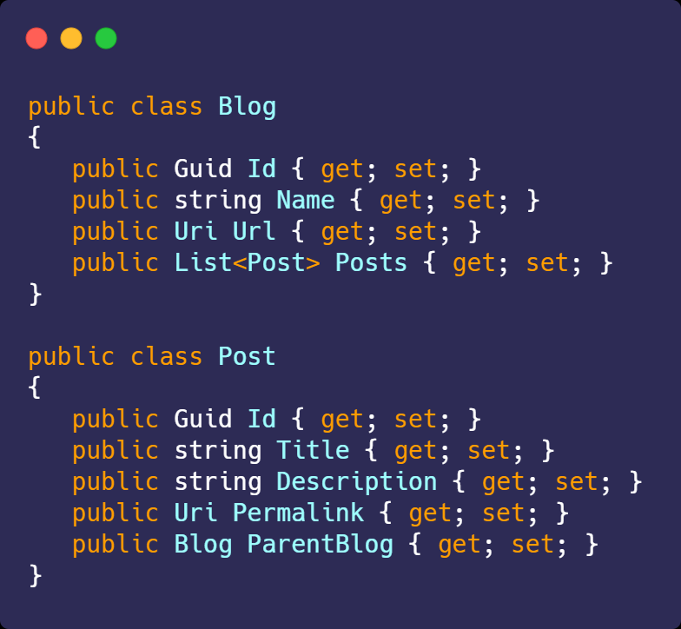
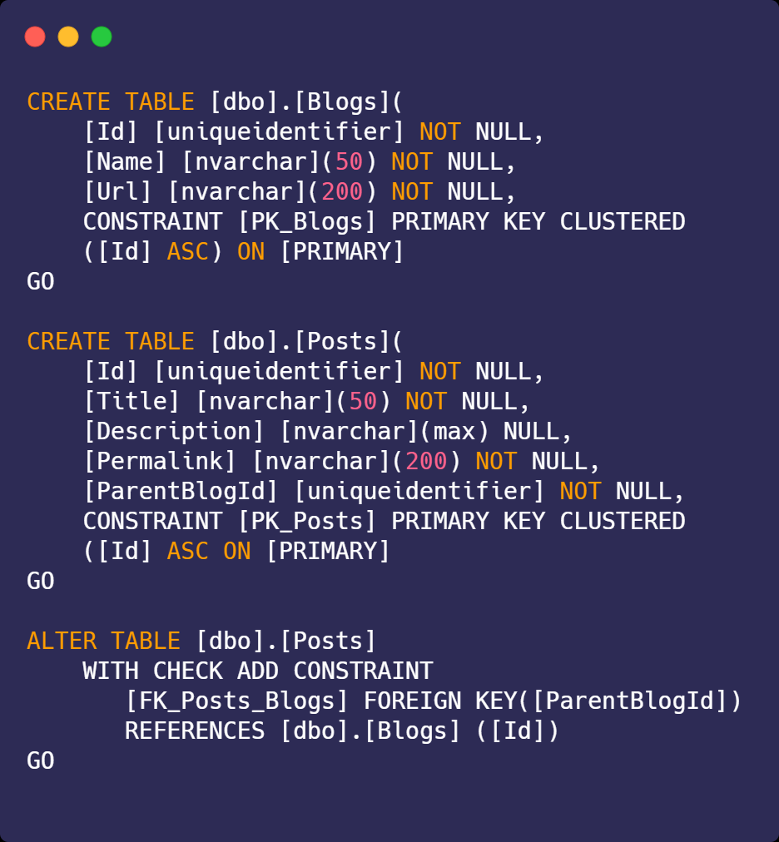
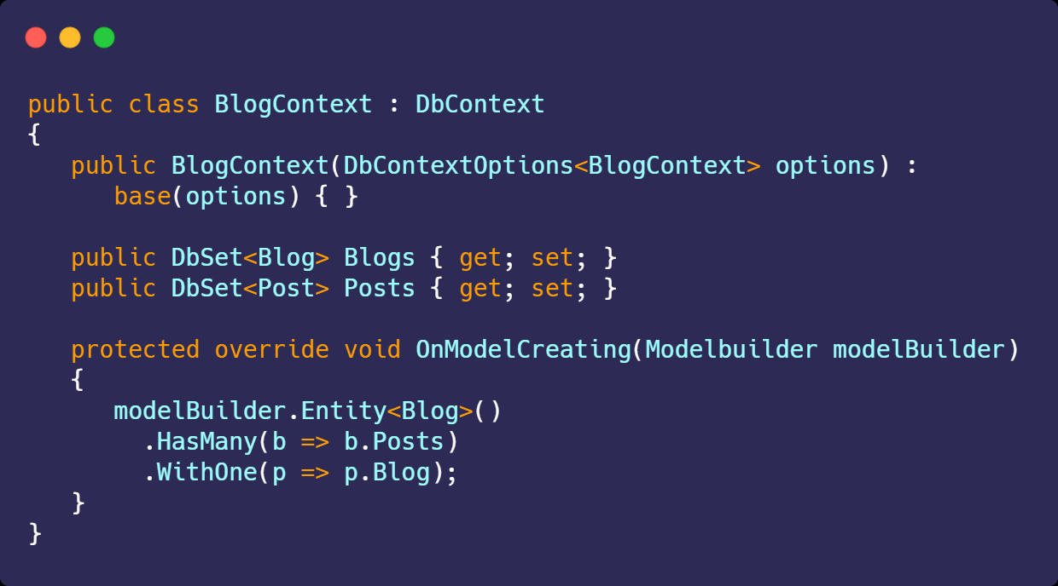
So, what is EF Core?
Entity Framework Core is a modern object-database mapper for .NET.
It supports LINQ queries, change tracking, updates, and schema migrations.
EF Core works with many databases, including Azure SQL Database, SQLite, MySQL, PostgreSQL, and Azure Cosmos DB.
Model
Database
Context

Slide 27






What is EF Core?
Use LINQ to write queries.
Work with your natural domain objects instead of property bags or data tables.
Use a single command to aggregate all changes in a complex object graph.
Fluently configure entity relationships.
Handle optimistic concurrency “out of the box.”
Interface with a consistent API across multiple database backends (SQL, SQLite, MySQL, PostgreSQL, Azure Cosmos DB)

Slide 28
What is EF Core?
... And of course, database schemas do change, so we help manage changes with migrations

Slide 29
What’s New in EF Core 6?
SQL Server Temporal Tables
Migration Bundles
Pre-convention Model Configuration
Compiled Models
Performance
Azure Cosmos DB Support
Reverse-Engineering
LINQ Enhancements
New Mapping Attributes
Model Building Improvements
DbContextFactory Improvements

Slide 30
Performance!
Data access performance = EF framework performance + database query performance
Basic principles:
Trim the shape of retrieved entities (projections + relationships)
Push as much as possible to the backend (functions, aggregations)
Have supporting indexes in place for filtering, sorting, aggregations, etc.
If you don't need it, turn of AsNoTracking() and avoid keep tracks of entity state on the client side.
With a well-optimized database tier and a canonical, OLTP workload, 100k or 100M rows won't make significant differences in query performance!

Slide 31
EFCore 6 performance: framework improvements
92% Improvement
Source: TechEmpower Fortunes Middleware EF benchmark

Slide 32
EFCore 6 performance: Compiled models
dotnet ef dbcontext optimize --output-dir MyCompiledModels --namespace MyCompiledModels

Slide 33
EFCore 6 performance: Compiled models

Slide 34
Demo
https://github.com/scoriani/azure-sql-db-client-stack

Slide 35
Azure SQL DB and EF Core 6: performance considerations

Slide 36
Modeling
When defining your EF models, check that they’re compatible with Azure SQL database objects
Data types, length, precision and scale
Use varchar / nvarchar properly (be aware of nvarchar(max) defaults for strings!)
Date/time values
to avoid
Implicit conversions leading to index scans and other inefficiencies
Bloating plan cache with new plan for every query
Inefficient search predicates
Controlling conventions
Define common behaviors across multiple entities, no need to specify every single time
Specifying Azure SQL Database Options

Slide 37
Demo
https://github.com/scoriani/azure-sql-db-client-stack

Slide 38
Querying
Push as much computation as possible to the server
Client vs Server evaluation
Raw SQL queries (or SPs) for full control on expressiveness and performance
Be mindful of the N+1 issue
Filtering and projections
Only load the data that you really need.
Balance Include(s) and Select(s) depending on size of the resultset vs multiple SQL commands.
Do I need change tracking?
Be aware of the overhead, unless it is needed for generating “Unit of Work” activities
Can turn it off at dbcontext level by calling .UseQueryTrackingBehavior(QueryTrackingBehavior.NoTracking)

Slide 39
Performance
Measure, measure, measure (e.g. https://benchmarkdotnet.org/)
From simple logging to complex diagnostics listeners
Pure database performance
Diagnose your queries in Azure SQL, look for the obvious (missing indexes, parameter sniffing, bad resource consumption, etc.)
Network data transfer
Implement efficient projection and filtering
Network roundtrips
Reduce chattiness, make sure to leverage batching for database interactions
EF runtime
Compiled queries, compiled models,

Slide 40
Demo
https://github.com/scoriani/azure-sql-db-client-stack

Slide 41
Next Steps
What’s new in EF Core 6.0?
EF Core Community Standups
Introduction to EF Core 6.0 Performance
Microsoft SQL Server EF Core Database Provider
EF Core 6 modeling
Querying data

Slide 42

Continue your SQL journey on Microsoft Learn
The next step to expanding your technical skills
Sharpen the technical skills you need to advance your career with free courses and designated learning paths.
58%
career opportunities improvement
58% of certified professionals report Azure certifications have helped them improve their career progression opportunities *
Advance your career in cloud data engineering
Build in-demand skills
Increase your productivity and efficiency
Get started at aka.ms/azuresqlfundamentals
* Nigel Frank Microsoft Azure Salary Survey (June 2020) https://www.nigelfrank.com/microsoft-azure-salary-survey/

Slide 43
Feedback link
Please submit your feedback here:
https://sqlb.it/?7220

Slide 44

Thank you!

